Slide 1



Web Development Session 3
Advanced HTML & CSS
Taught by the CST Web Development Team

Slide 2
Up for Today
HTML Recap
Advanced HTML
CSS Recap
Advanced CSS
Task
Assignment

Slide 3
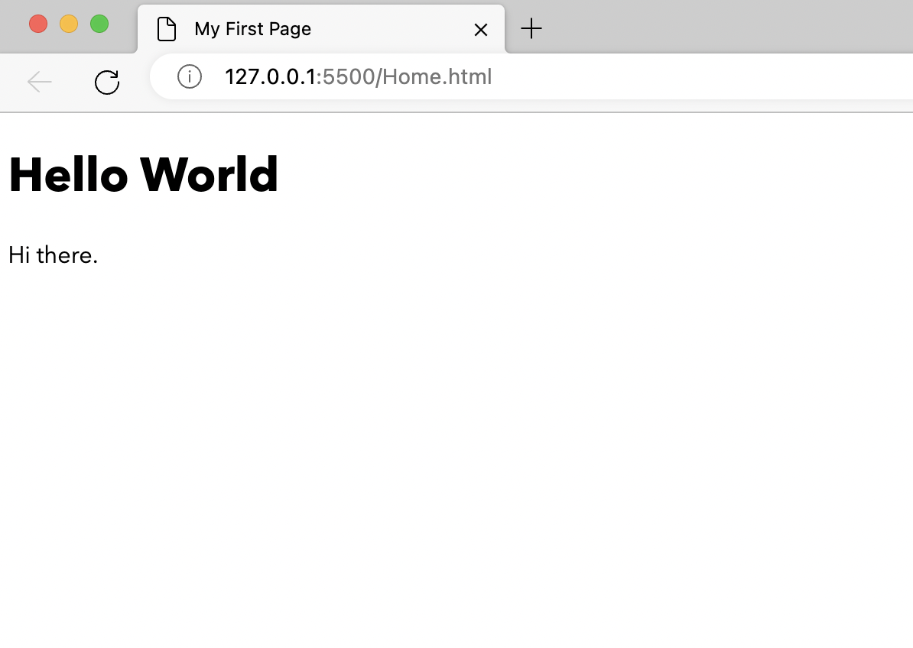
HTML Recap: Hello World
<!DOCTYPE html>
<html>
<head>
<title>My First Page</title>
</head>
<body>
<h1>Hello World</h1>
<p>Hi there</p>
</body>
</html>

Slide 4
HTML Recap: Hello World
<!DOCTYPE html>
<html>
<head>
<title>My First Page</title>
</head>
<body>
<h1>Hello World</h1>
<p>Hi there</p>
</body>
</html>
<html>
<head>
<script>
<body>
Page Metadata
!DOCTYPE html
<style> or <link>
HTML for Page Content

Slide 5
HTML Recap: Head Tag
<html>
<head>
<meta charset="UTF-8">
<meta name="keywords" content="Pets, Cats and Dogs">
<meta name="description" content="Free Kitties">
<title>A Meaningful Page Title</title>
<link rel="icon" type="image/x-icon" href=”imgur.com/abc">
<style>
...
</style>
<link rel="stylesheet" href="mystyle.css">
</head>
</html>

Slide 6
HTML Recap: Basic Tags
Headings <h1>content</h1>...<h6>content</h6>
Paragraphs <p>content</p>
New Blank Line <br/>
New Line <hr/>
Anchor <a href= ”link” target="_self">link text</a>
Image <img src= "./img.jpg" alt= "cat Image"/>
Division <div>HTML</div>
Span <span>CONTENT</span>
<pre> for formatting
Likewise, video and audio

Slide 7
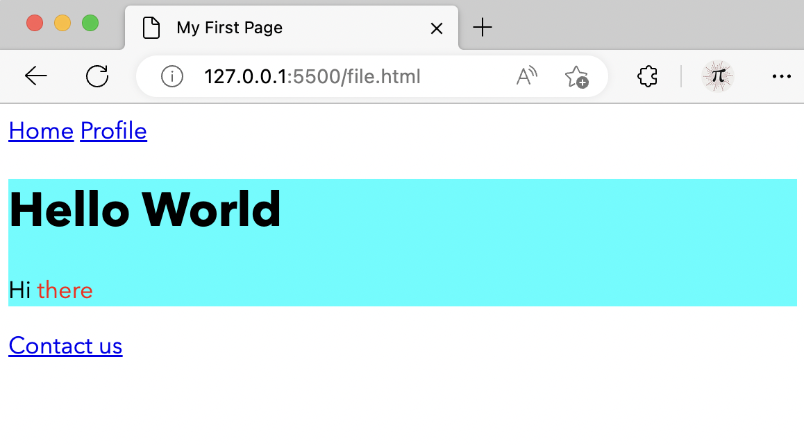
Hello World + DIV & SPAN
<body>
<a href="./home.html">Home</a>
<a href="./profile.html">Profile</a>
<div style="background-color:aqua">
<h1>Hello World</h1>
<p>Hi <span style="color:red">there</span></p>
</div>
<a href="./contact.html">Contact us</a>
</body>

Slide 8
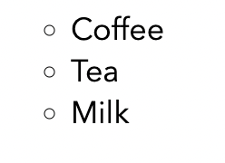
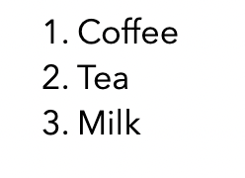
HTML Recap: Lists
<body>
<ul type="circle">
<li>Coffee</li>
<li>Tea</li>
<li>Milk</li>
</ul >
</body>
How do we achieve?

Slide 9
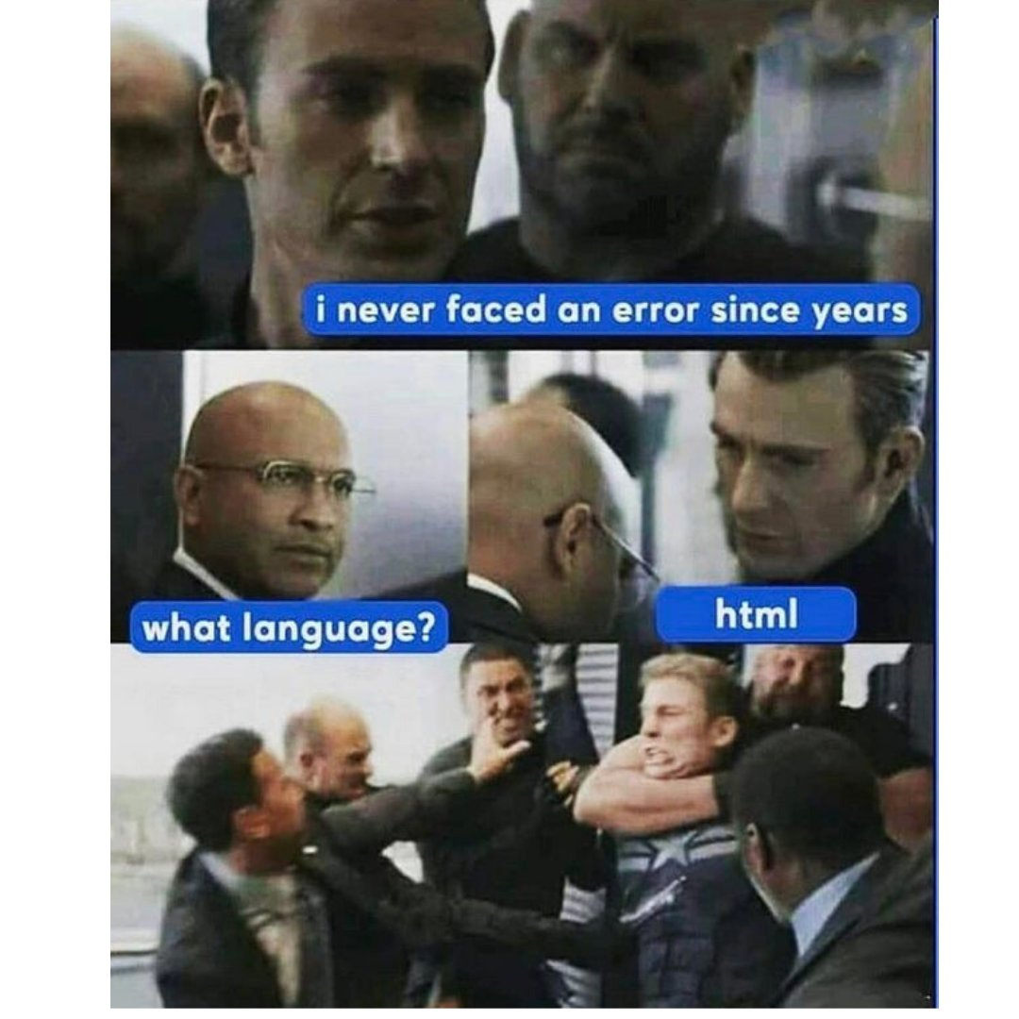
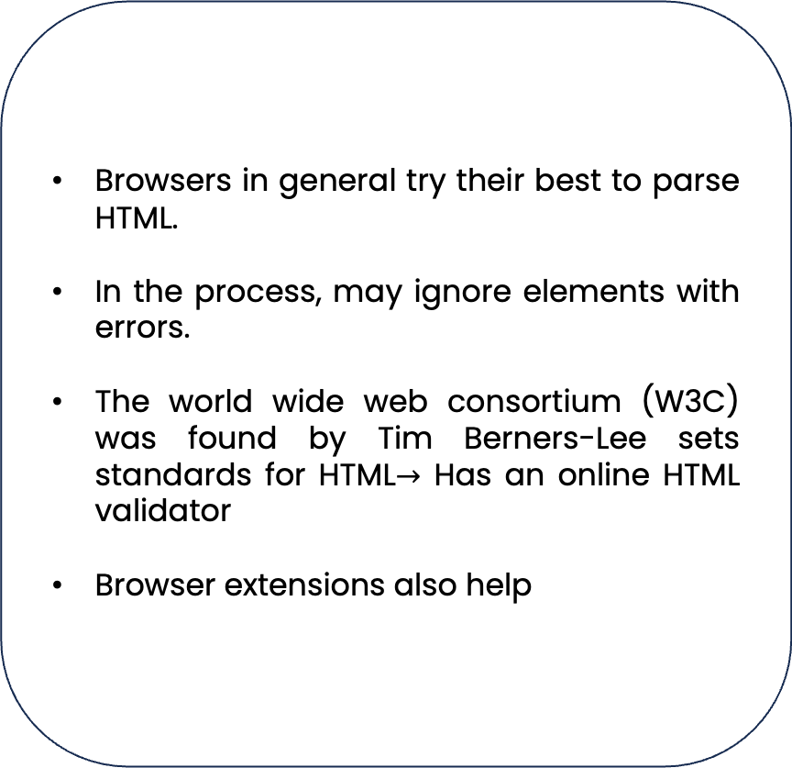
HTML Errors
Browsers in general try their best to parse HTML.
In the process, may ignore elements with errors.
The world wide web consortium (W3C) was found by Tim Berners-Lee sets standards for HTML$→$ Has an online HTML validator
Browser extensions also help

Slide 10
HTML Recap: Forms
<form action="./submit_form.php" method="post">
<label for=”...” >Text Input:</label>
<input type="text" id=”..." name="text_input" placeholder=”abc" required>
</form>
Some Available Types
text | password | email, url | number | date | checkbox | file | color | range | submit, reset

Slide 11
Forms (Radio Button)
<!-- Radio Buttons -->
<label>Radio Buttons:</label>
<label for=”r1">Option 1</label>
<input type="radio" id=”r1" name="radio_options" value="option1">
<label for=”r2">Option 2</label>
<input type="radio" id=”r2" name="radio_options" value="option2">

Slide 12
Forms (Dropdown)
<!-- Select Dropdown -->
<label for="select_input">Select:</label>
<select id="select_input" name="select_input" required>
<option value="">Select an option</option>
<option value="option1">Option 1</option>
<option value="option2">Option 2</option>
<option value="option3">Option 3</option>
</select>

Slide 13
Forms (Text Area & Submit)
<!-- Textarea Input -->
<label for="textarea_input">Textarea:</label>
<textarea id="textarea_input" name="textarea_input" rows="4" cols="50" required>
</textarea>
<!-- Submit Button (more flexible; preferred) -->
<button type="submit” onclick=“” >Submit</button>

Slide 14
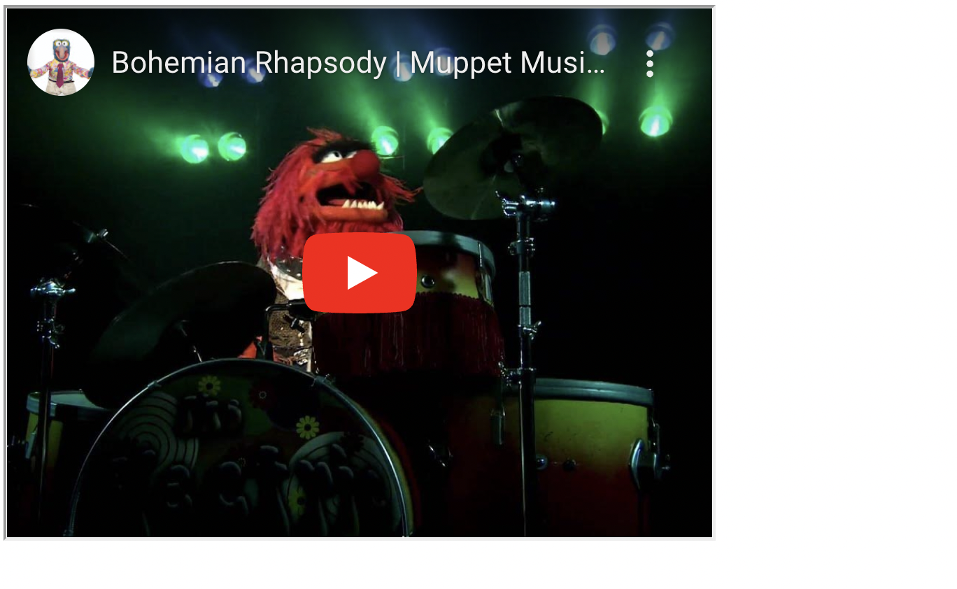
Iframes
<iframe width="420" height="315"
src="https://www.youtube.com/embed/tgbNymZ7vqY">
</iframe>
To open another website in your website (e.g., video or Google maps)

Slide 15
Text Formatting
<b> | Defines bold text
<i> | Defines italic text
<em> | Semantic Italic
<strong> | Semantic Bold
<sub> | Defines subscripted text
<sup> | Defines superscripted text
<ins> | Defines inserted text (underlined)
<del> | Defines deleted text (strikethrough)
<mark> | Defines marked/highlighted text
All achievable with CSS but some also carry semantic meaning

Slide 16
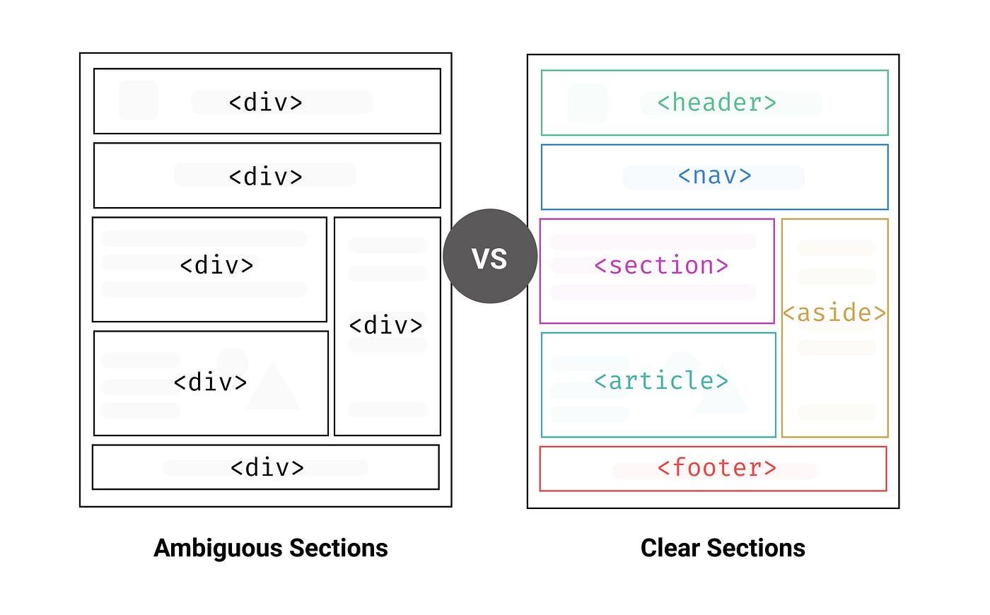
Division Semantic Alternatives
Also <figure> and <figcaption>

Slide 17
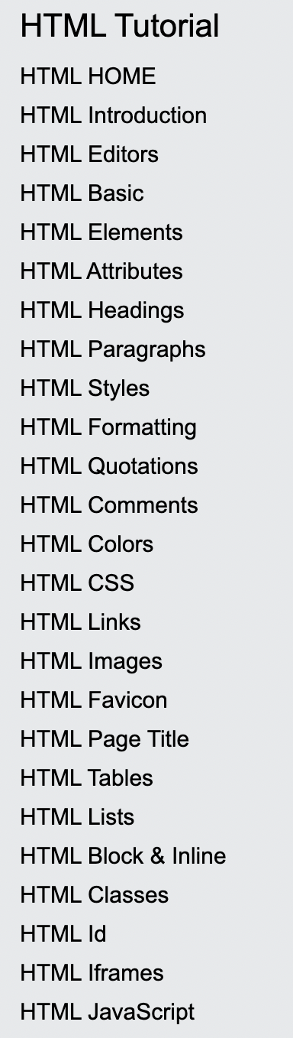
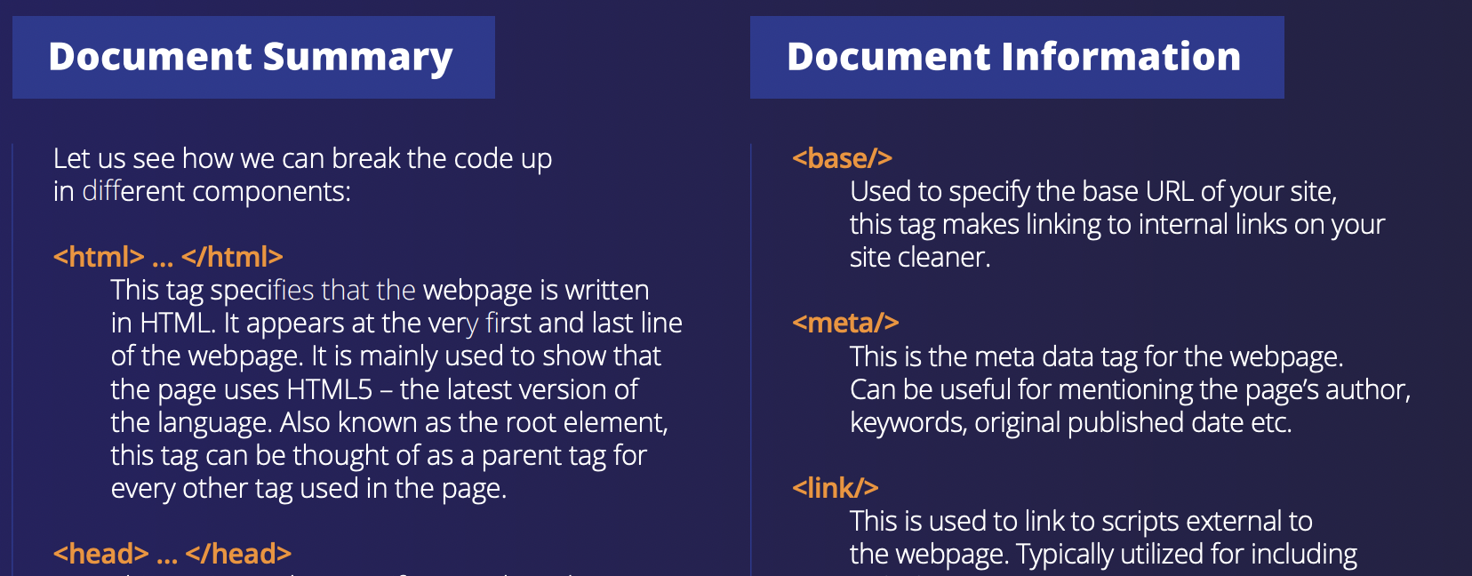
HTML References
Official Documentation at Mozzila
W3 Schools, HTML cheat sheets
Our book (HTML & CSS by Jon Ducket)

Slide 18
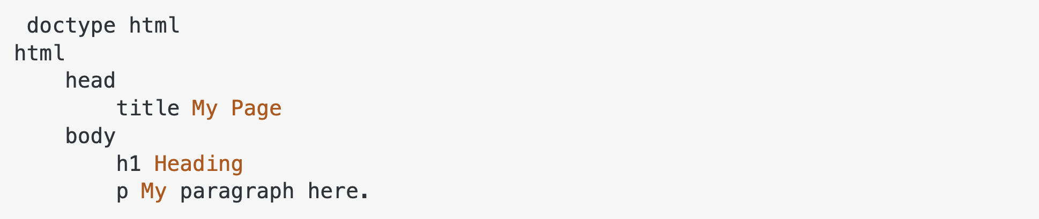
HTML Alternatives
Majority are just happy with HTML; browsers only support HTML
Attempts to at least extend it, have been somewhat successful (e.g., Pug.js, Jinja,..)
But currently dying
Another popular and simpler format for documents is markdown

Slide 19
So Far
Recapped on HTML (Hello World, Head, Basic Tags)
Understood div, span and HTML errors
Understood forms and the different types of input
Iframes and text formatting
Semantic HTML
References and Alternatives

Slide 20
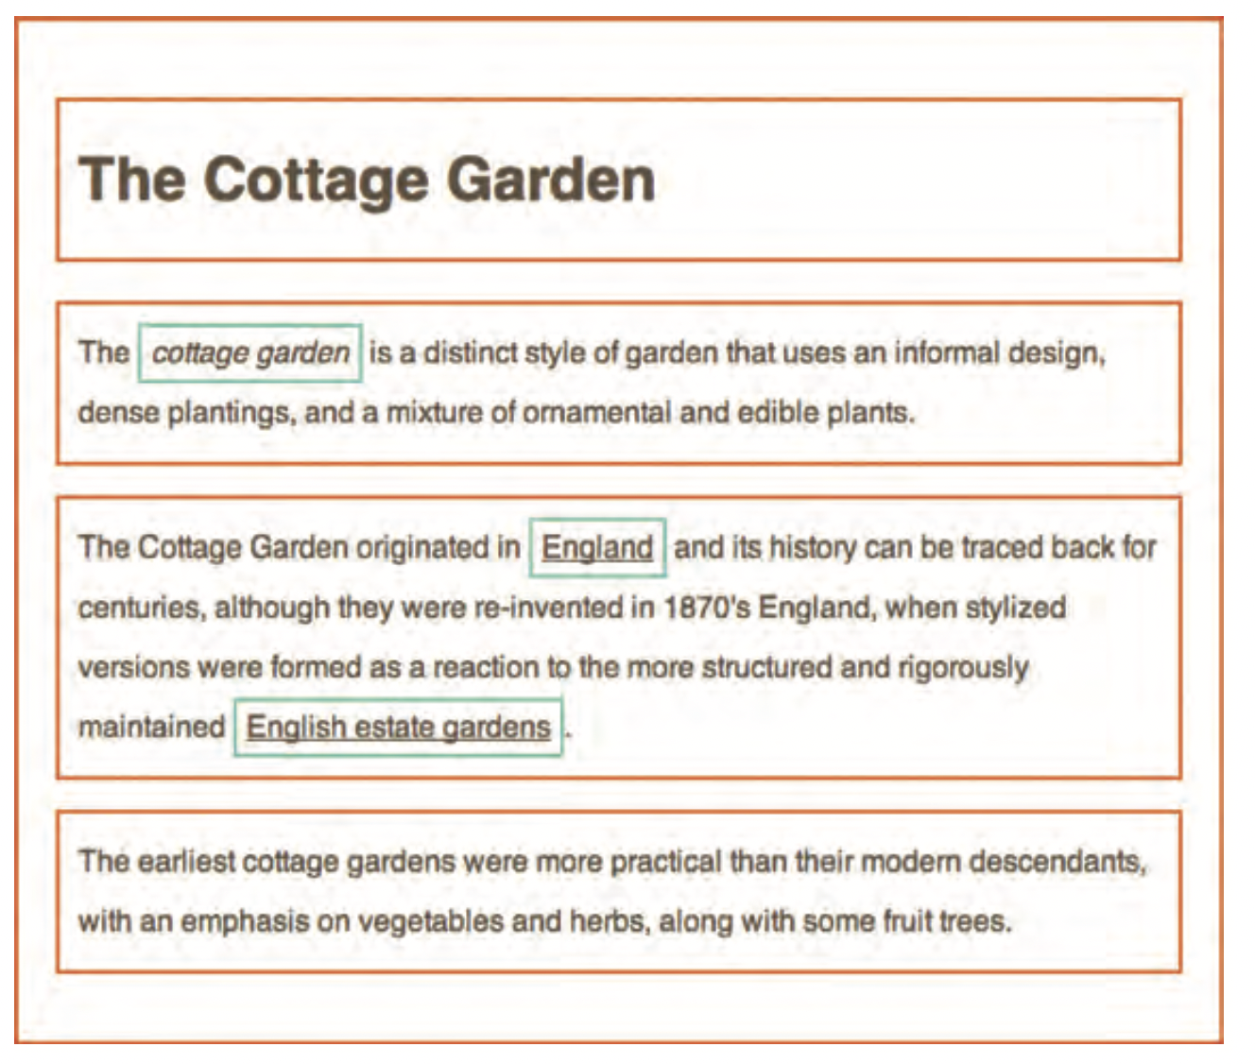
CSS Introduction
CSS treats any element as a box
There are five main types of styles to apply to such boxes
Text Styles (Content)
Box Styles
Layout Styles
Element-specific Styles
Animations

Slide 21
CSS Recap: Syntax
CSS syntax
Selector {
property: value;
property: value;
…
}
CSS syntax
p {
font-family: Arial;
Font-size: 150;
…
}
Inline: <tag style=“propery: value; property: value”> content </tag>

Slide 22
CSS Recap: Selectors
Selector | Example | Meaning
Universal Selector | * { … } | Select all elements
Type Selector | p {…} | Select all elements of type p
Descendant Selector | p a {…} | Select all elements of type a inside any element of type p
Child Selector | p > a {…} | … must be a direct child
Class Selector | .note {…} | Select all elements with class=“note”
Type-Class Selector | p.note {…} | Select all elements of type p with class=“note”
ID Selector | #intro {…} | Select the element with id=“intro”
Attribute Selector | [input=“submit”] | Select elements with input=“submit”
Pseudo-class Selector | button:hover, focus, active | Apply style when mouse hovers
Pseudo-element | div::after, before | Insert content at the end of the div
A, B, C {…} to combine selectors

Slide 23
CSS Recap: Cascading
Use styles defined as inline styles
Use non-conflicting internal styles
Use non-conflicting external styles
Use non-conflicting browser defaults
If two internal or external styles are conflicting, more specific one wins
If two styles with same specificity are conflicting, last one wins
To force a style to win use property: value !important;

Slide 24
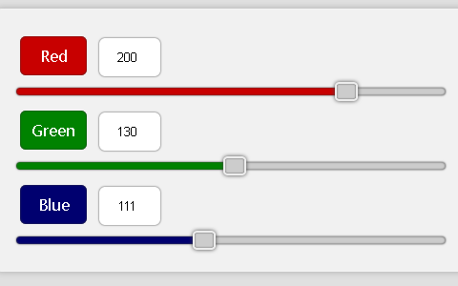
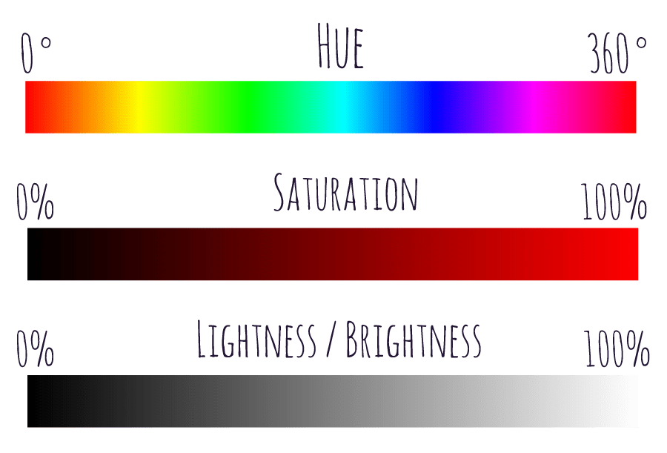
CSS Recap: Colors
color (or background-color): red; opacity: 1.0;
red | rgb(255,0,0) | rgba(255,0,0, 1) | #FF0000 | hsl(0, 100%, 50%) | hsla(0, 100%, 50%, 1)

Slide 25
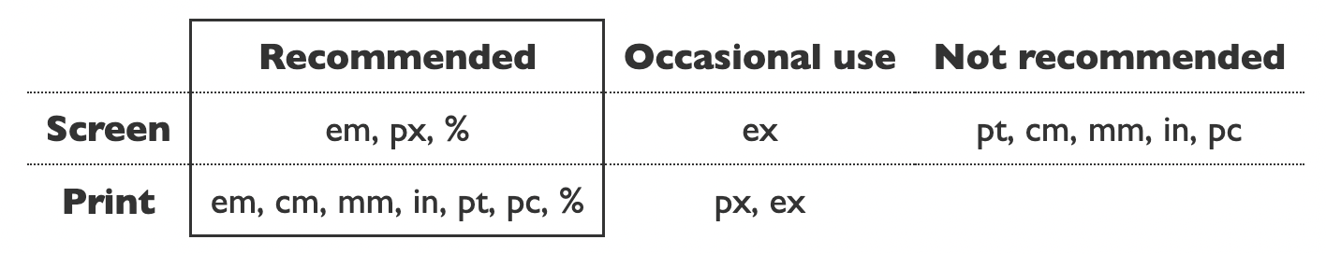
CSS Recap: Units
W3C has recommendations
px are just screen pixels
1em = font size of current element & 1rem = font size of root element
% uses the width/height/font size of the parent

Slide 26

CSS Recap: Units
<body>
<div style="background-color: skyblue; width: 100%; height: 100%;">
<div style="width: 50%; height: 50%; background-color:yellow;">
</div>
</div>
</body>

Slide 27
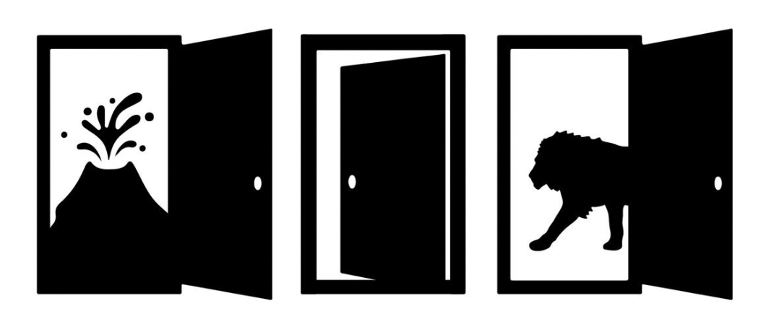
Brain Teaser
You’re escaping a maze, and there are three doors in front of you. The door on the left leads to a pit of lava. The door in the center leads to a room filled with deadly gas. The door on the right leads to a family of lions that haven’t eaten in three months. Which door do you choose?

Slide 28
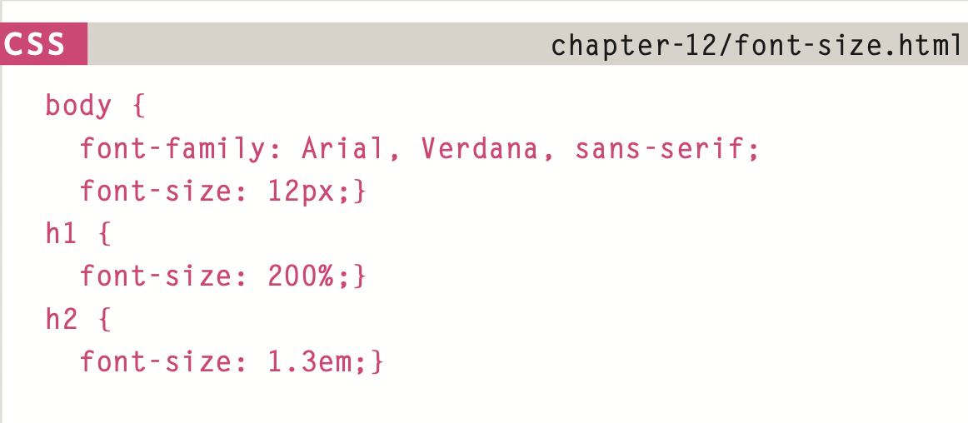
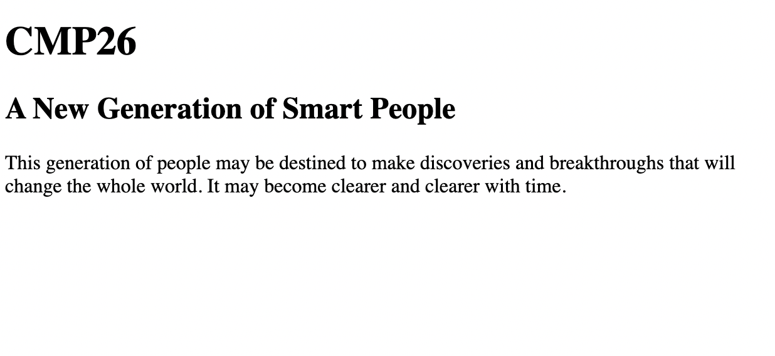
Text Styles
font-family, font-size & inheritance
CSS
Output
For New Fonts: @font-face { font-family: 'ChunkFiveRegular'; src: url('fonts/chunkfive.eot’);} (Check Google Fonts)

Slide 29
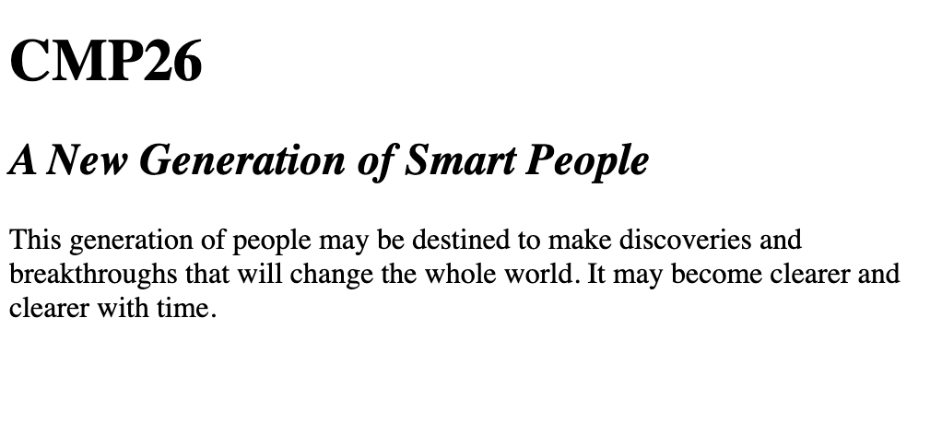
Text Styles
font-style and font-size
h1 {
font-weight:600;
}
h2 {
font-style: italic;
}
CSS
Output
Both default to “normal”.
Number given to font-weight must be a multiple of 100 (can also be bold).

Slide 30
Text Styles
text-transform and text-decoration
h1 {
text-transform: uppercase;
}
h2 {
font-style: italic;
text-decoration: underline;
}
CSS
Output
Text-transform also takes lowercase or capitalize or none
Text-decoration also takes overline, line-through or none

Slide 31
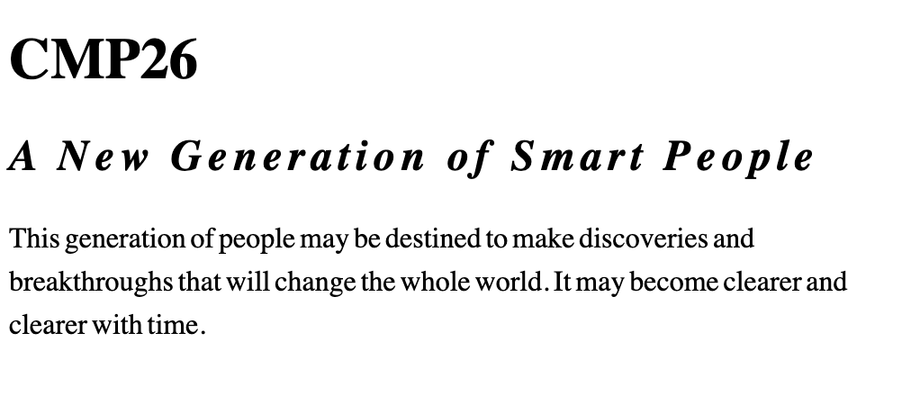
Text Styles
line-height and spacing
h2 {
font-style: italic;
letter-spacing: 0.2rem;
}
p {
line-height:1.5rem;
word-spacing: -0.1rem;
}
CSS
Output
letter and word-spacing are additive

Slide 32
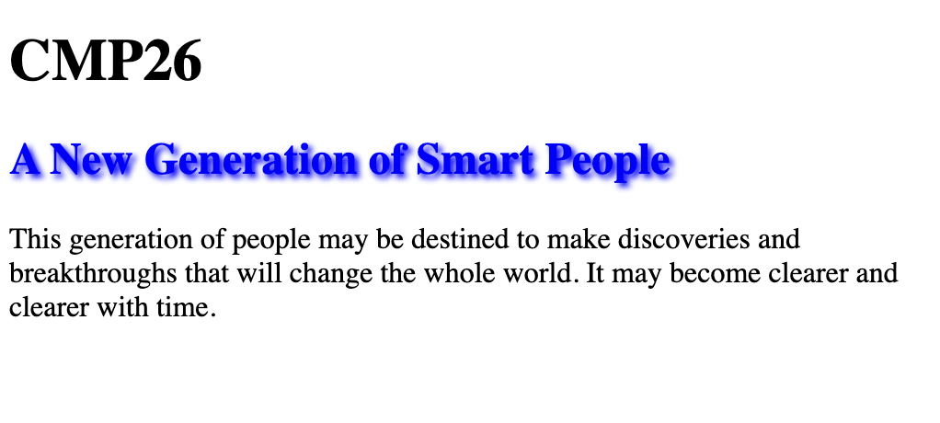
Text Styles
text-shadow
h2 {
color: blue;
text-shadow: 2px 2px 3px blue
}
CSS
Output
How much should the shadow drop to the right, down, amount of blur and color

Slide 33
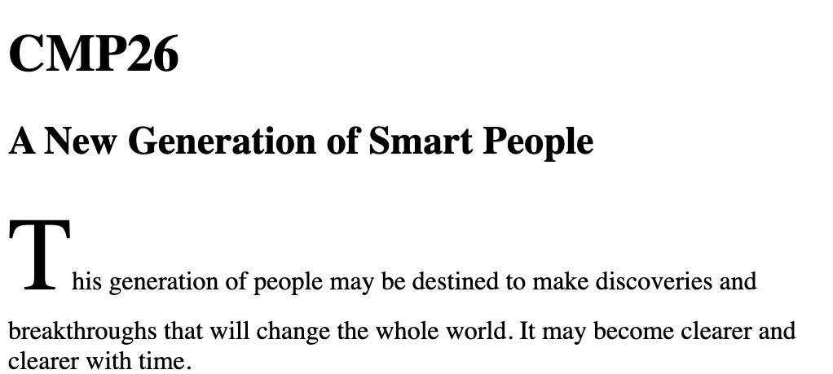
Text Styles
Pseudo-elements
p::first-letter {
font-size: 4em
}
CSS
Output
There is also a first-line pseudo-element

Slide 34
So Far
Recapped on HTML (basics, grouping, forms, semantics)
CSS associates HTML elements with styles using selectors
CSS treats any HTML element as a box
There are text styles, box styles, layout styles, element-specific styles and animations
Understood colors and units
Understood text styles

Slide 35
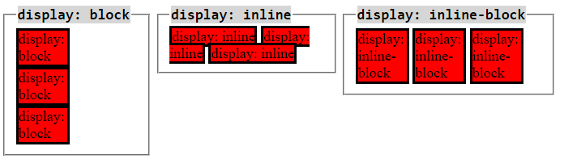
Box Styles
display
There are two types of HTML elements (in terms of default display)
display: block; | display: inline;
Takes width of its full container | Takes only the width needed for content
Doesn’t allow another element to sit next to it | Allows another element to sit next to it
Respects width, height, margin, padding | May only respect horizontal margin or padding
E.g., <h1>, <p>, <div> | e.g., <img>, <a>, <label>, <input>
Default behavior can be changed with display property
Inline-block is also an option (inline that allows box styling)
Display also has a role in layouts

Slide 36
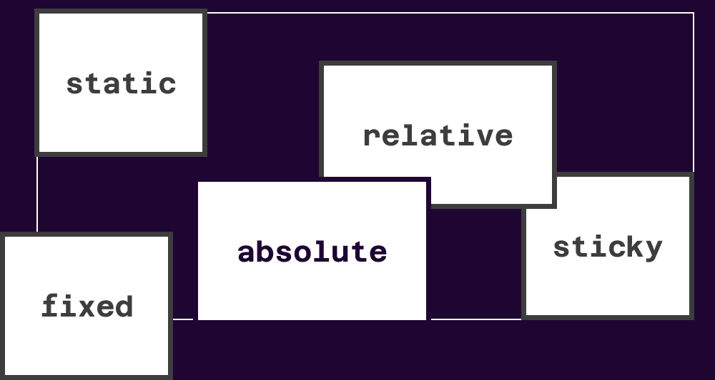
Box Styles
position
It’s possible to change the intended position of an element from static
.container {
position: relative;
top: 10px;
left: 30px;
z-index: 30;
}

Slide 37
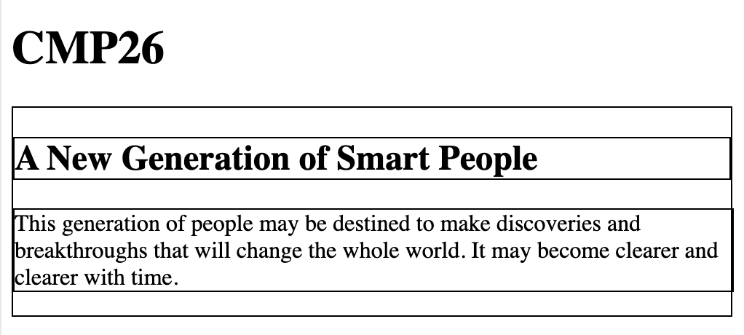
Box Styles
border
.container { border: 1px solid black;}
h2 { border: 1px solid black;}
p {border: 1px solid black;}
CSS
Output
Can alternatively specify border-width, border-style and border-color

Slide 38

Box Styles
border-radius
.container {
border: 1px solid black; border-radius: 1rem;
}
h2 { border: 1px solid black;}
p {border: 1px solid black;}
CSS
Output
There is also border-radius

Slide 39
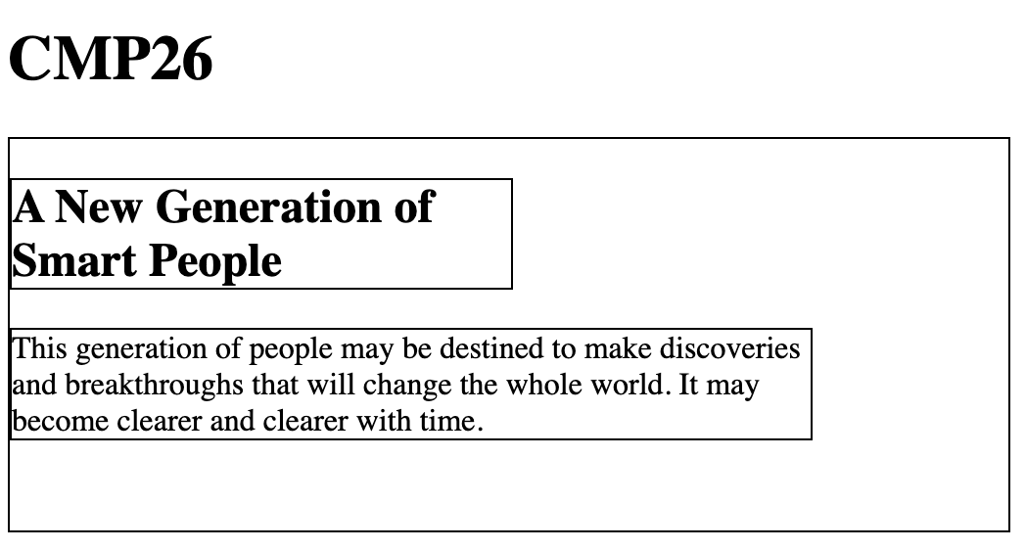
Box Styles
width, height
.container {
border: 1px solid black;
height: 200px;}
h2 {
border: 1px solid black; width: 50%;
}
p {
border: 1px solid black; width: 80%;
}
CSS
Output
Percentage is responsive

Slide 40
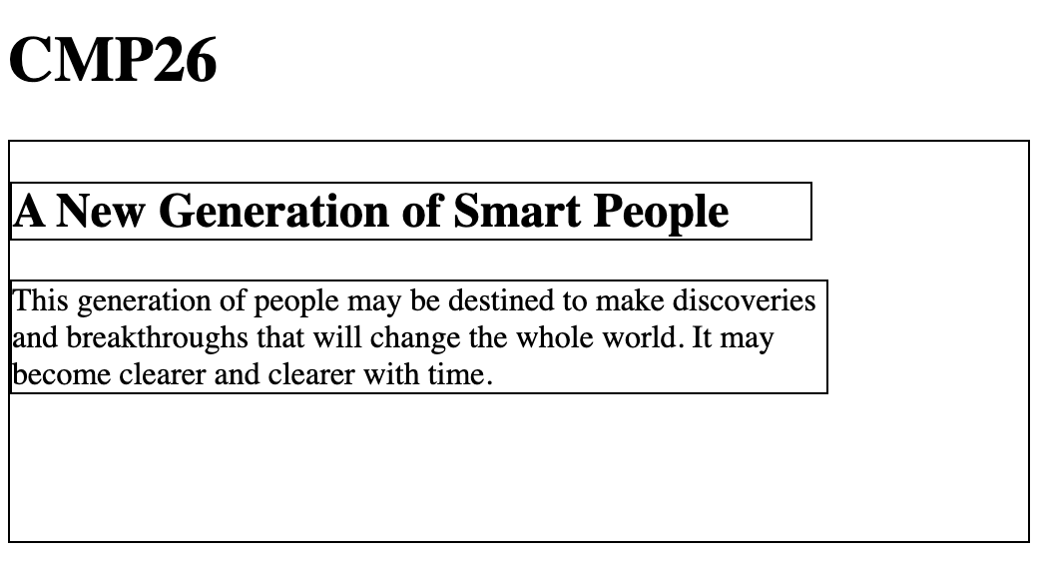
Box Styles
min\max-width, min\max-height
.container {
border: 1px solid black;
height: 200px;
}
h2 {
border: 1px solid black;
min-width: 400px;
width: 50%;
}
CSS
Output
Can limit the responsiveness

Slide 41
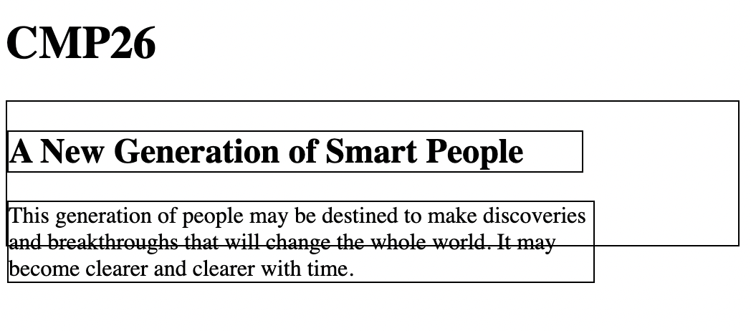
Box Styles
overflow
.container {
border: 1px solid black;
height: 100px;
overflow: none;
}
h2 {
border: 1px solid black;
min-width: 400px;
width: 50%;
}
CSS
Output
Height is not sufficient

Slide 42
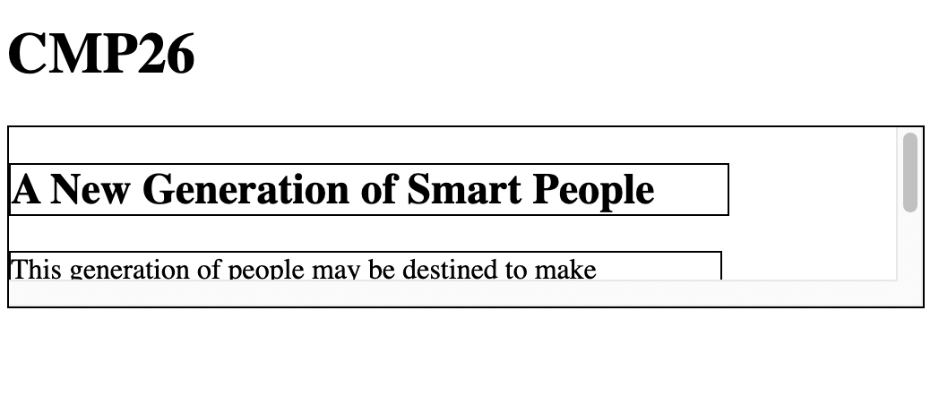
Box Styles
overflow
.container {
border: 1px solid black;
height: 100px;
overflow: scroll;
}
h2 {
border: 1px solid black;
min-width: 400px;
width: 50%;
}
CSS
Output
Overflow hidden is also possible (ignores the overflowing part)

Slide 43
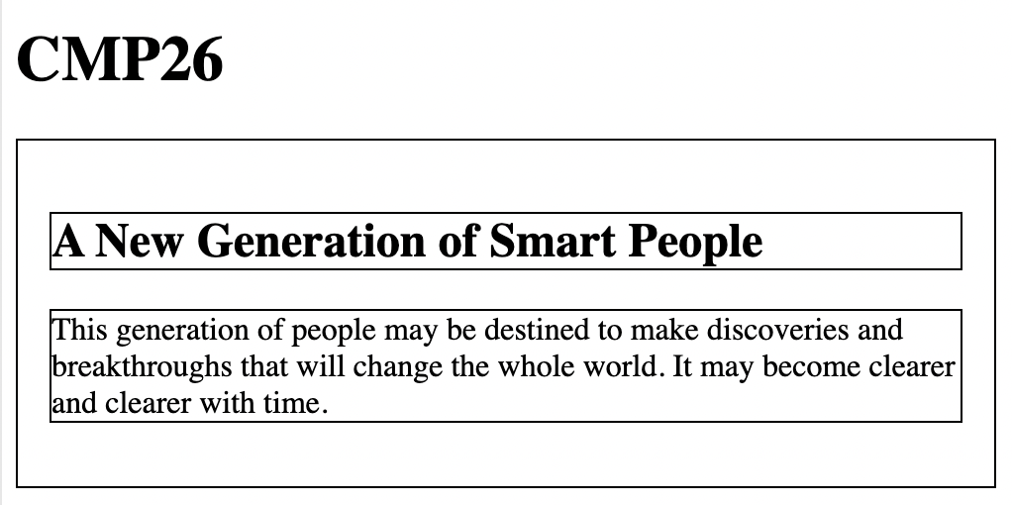
Box Styles
padding
.container {
border: 1px solid black;
padding: 1rem 1rem;
}
CSS
Output
This specifies the vertical and horizontal padding
Can also specifies for all four directions in clockwise order or using e.g., “padding-left”

Slide 44
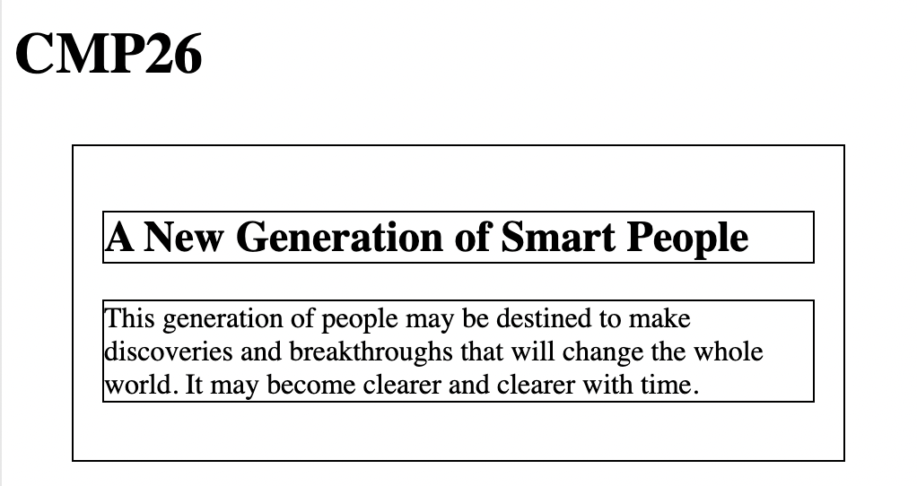
Box Styles
margin
.container {
border: 1px solid black;
padding: 1rem 1rem;
margin: 2rem;
}
CSS
Output
Margin specifies the spacing between the border and other elements

Slide 45
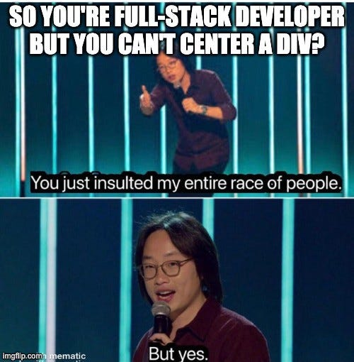
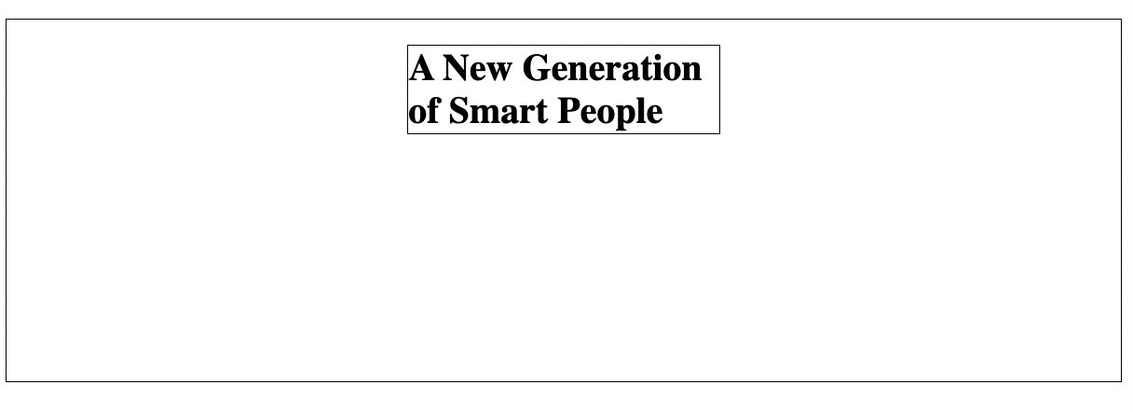
Box Styles
Centering Block Items
.container {
border: 1px solid black;
padding: 1rem 1rem;
height: 200px;
}
h2 {
margin: auto;
}

Slide 46
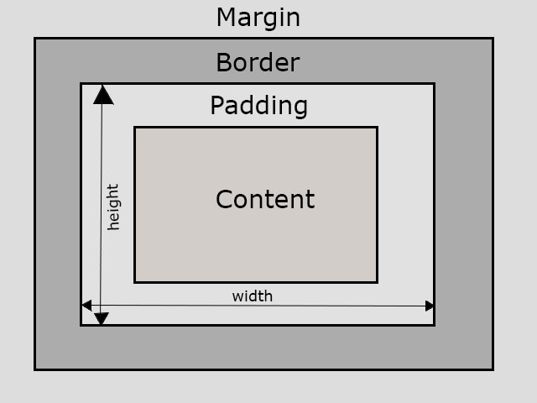
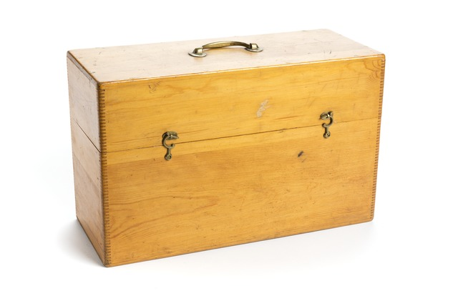
Box Styles
CSS BOX Model
Any Element for CSS is a Box!
Space occupied by any HTML element includes its content, padding, border-width and margin

Slide 47
Box Styles
visibility
visible
hidden
Unlike display: none; other elements will still pretend it exists.

Slide 48
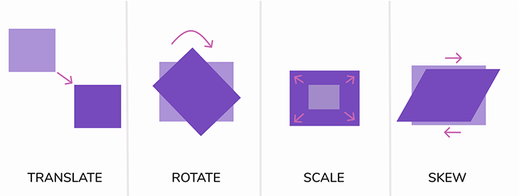
Box Styles
transform
For instance

Slide 49
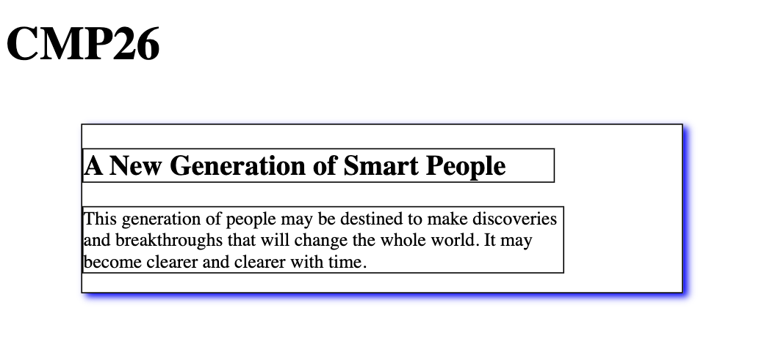
Box Styles
transform
.container {
border: 1px solid black;
box-shadow: 4px 3px 6px blue;
transform: scale(0.8);
}
CSS
Output
Can also specify scaleX or scaleY and (scaleZ if a 3D space is created with perspective.)

Slide 50
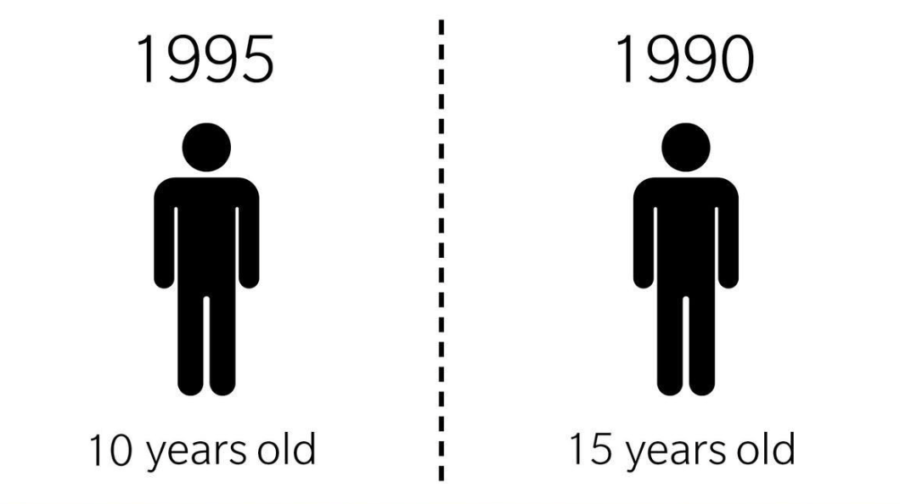
Brain Teaser
In 1990, a person is 15 years old. In 1995, that same person is 10 years old. How can this be?

Slide 51
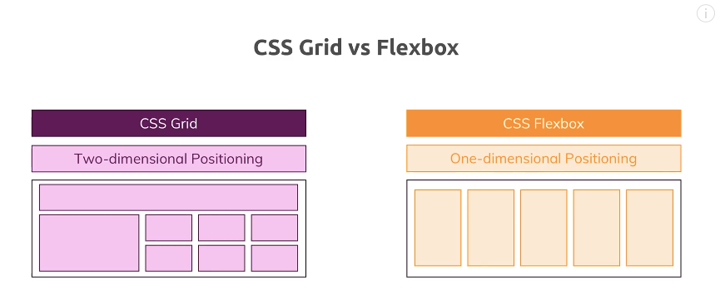
Layout Styles
Two Layout Systems
Specialized for 2D Layouts
For 1D Horizontal or Vertical
Also 2D but Less Control

Slide 52
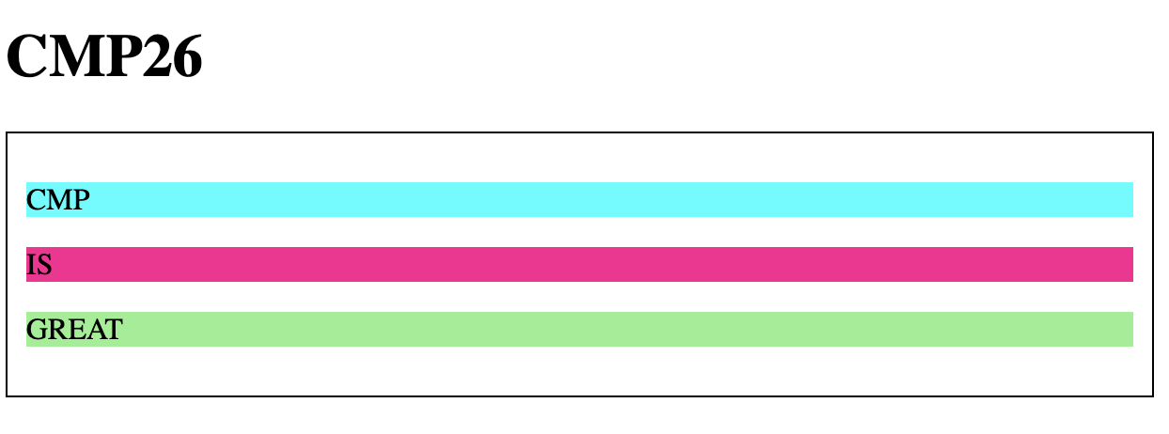
CSS Layout
Purpose: Make a layout
<div class="container" style="border: 1px solid black; padding: 10px;"">
<div class="c1" style="background-color:aqua"><p>CMP</p></div>
<div class="c2" style="background-color: DeepPink"><p>IS</p></div>
<div class="c3" style="background-color:LightGreen"><p>GREAT</p></div>
</div>
Given: Blocks with any content

Slide 53
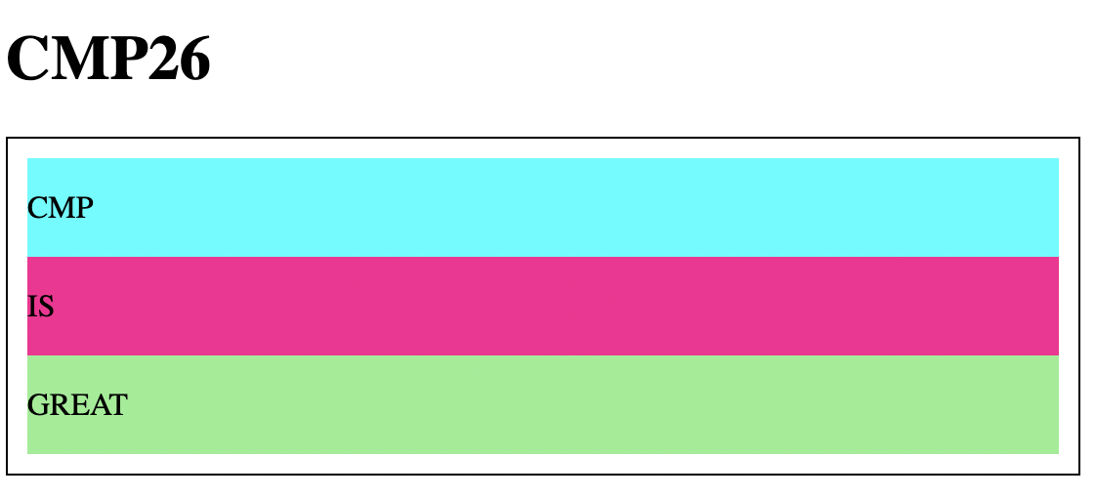
Layout: CSS Grid
display
.container {
display: grid;
}
CSS
Output
By default grid will divide the height equally

Slide 54
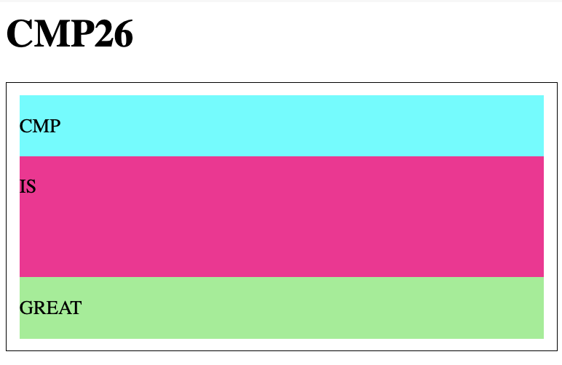
Layout: CSS Grid
grid-template-rows (px)
.container {
display: grid;
grid-template-rows: 50px 100px;
}
CSS
Output
We can force first and second row to take specific heights

Slide 55
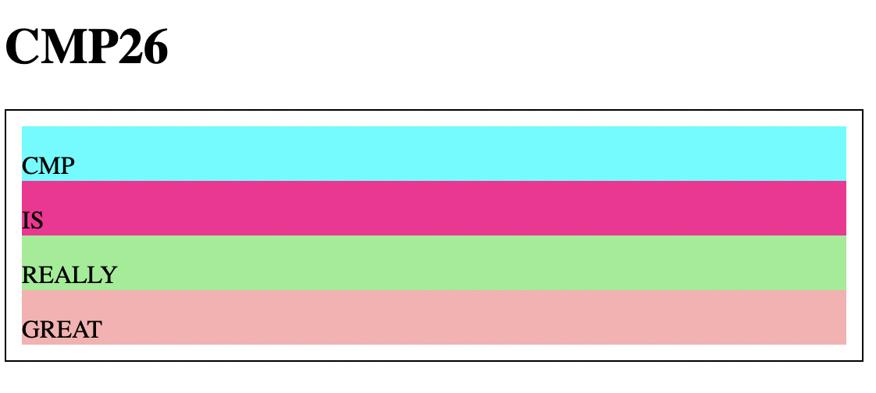
Layout: CSS Grid
grid-template-rows (repeat)
.container {
display: grid;
grid-template-rows: repeat(4, 35px);
}
CSS
Output
can repeat a dimension

Slide 56
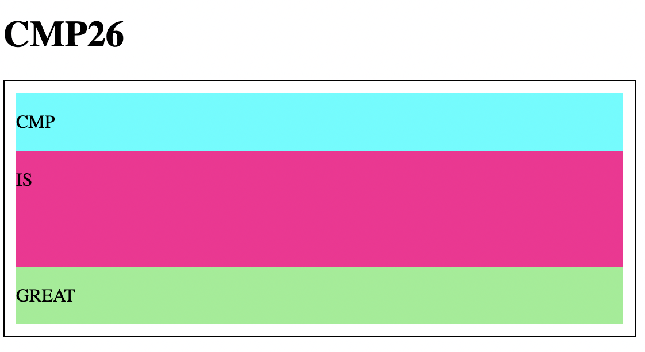
Layout: CSS Grid
grid-template-rows (fr)
.container {
display: grid;
grid-template-rows: 1fr 2fr 1fr;
}
CSS
Output
Or force ratios for them

Slide 57
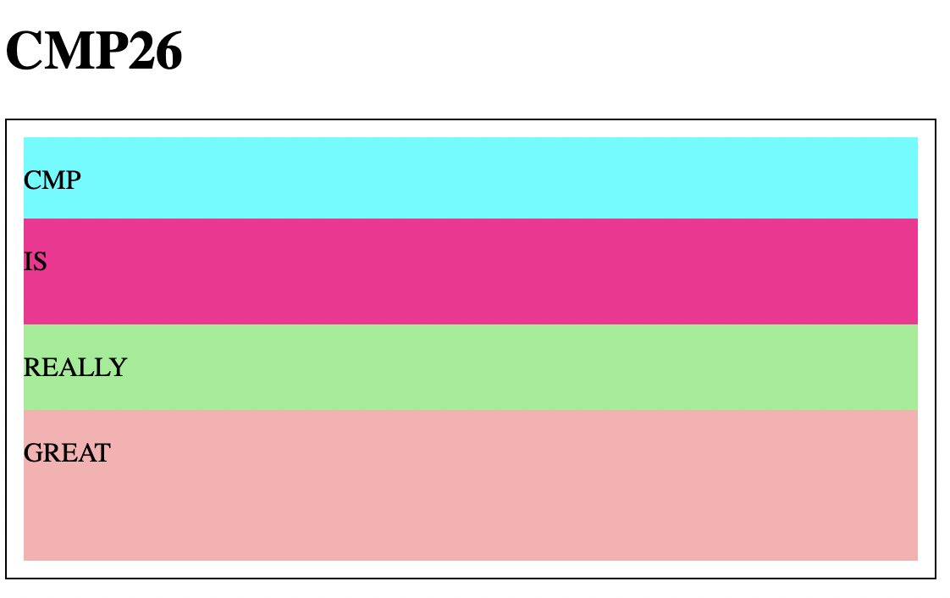
Layout: CSS Grid
grid-template-rows (mix)
.container {
display: grid;
grid-template-rows: 3rem 25% 1fr 2fr;
}
CSS
Output
Or a mix of that

Slide 58
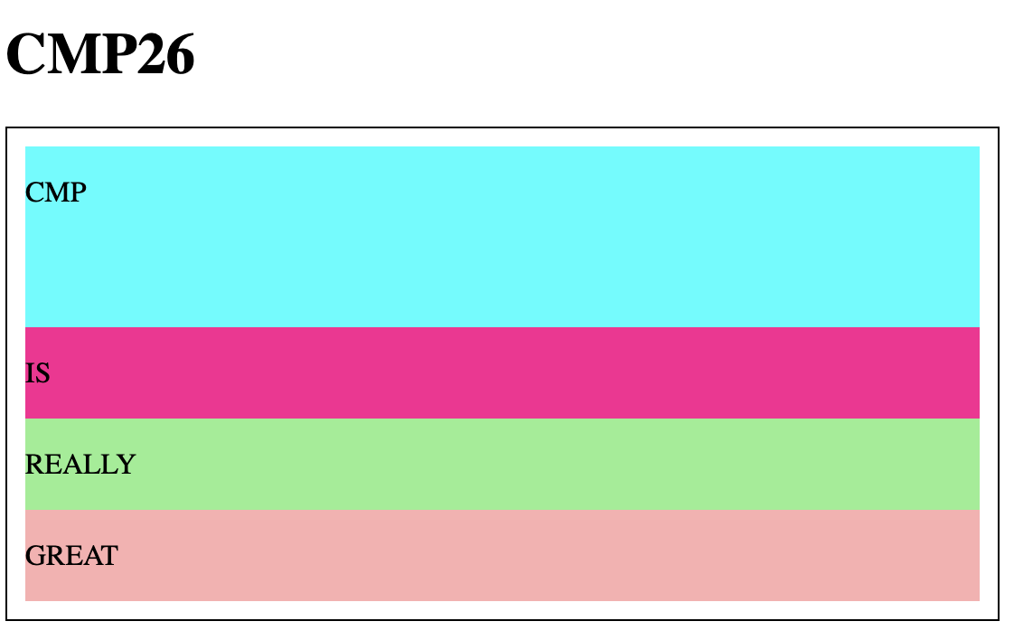
Layout: CSS Grid
grid-template-rows (minmax)
.container {
display: grid;
grid-template-rows: minmax(70px, 100px);
}
CSS
Output
Take height max if possible but never go below min

Slide 59
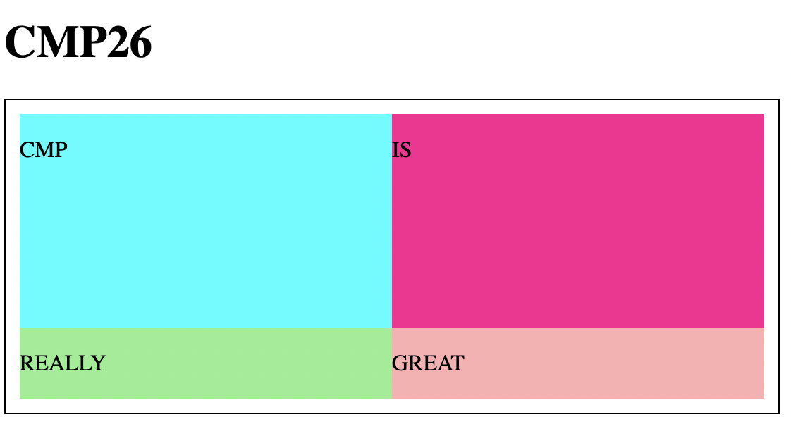
Layout: CSS Grid
grid-template-columns
.container {
display: grid;
grid-template-rows: 3fr 1fr;
grid-template-columns: 1fr 1fr;
}
CSS
Output
All options considered earlier apply

Slide 60
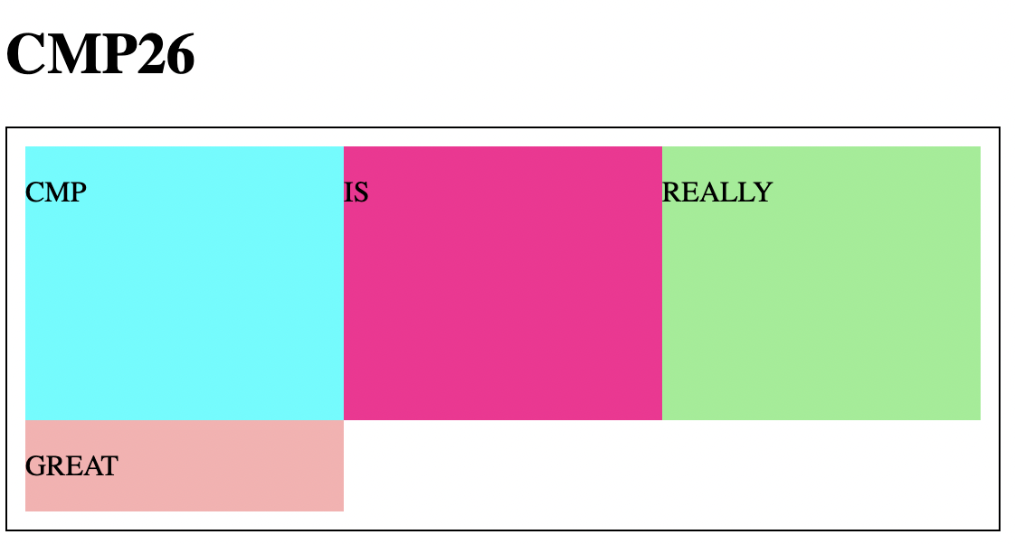
Layout: CSS Grid
grid-template-columns
.container {
display: grid;
grid-template-rows: 3fr 1fr;
grid-template-columns: 1fr 1fr 1fr;
}
CSS
Output
All options considered earlier apply

Slide 61
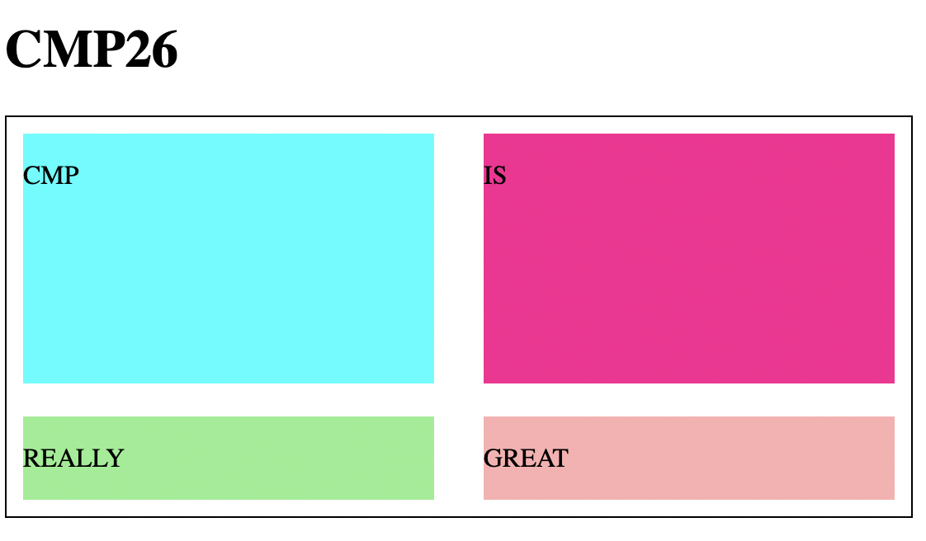
Layout: CSS Grid
grid-gap
.container {
display: grid;
grid-template-rows: 3fr 1fr;
grid-template-columns: 1fr 1fr;
grid-gap: 20px 30px;
}
CSS
Output
There is algo grid-gap-row and grid-gap-column

Slide 62
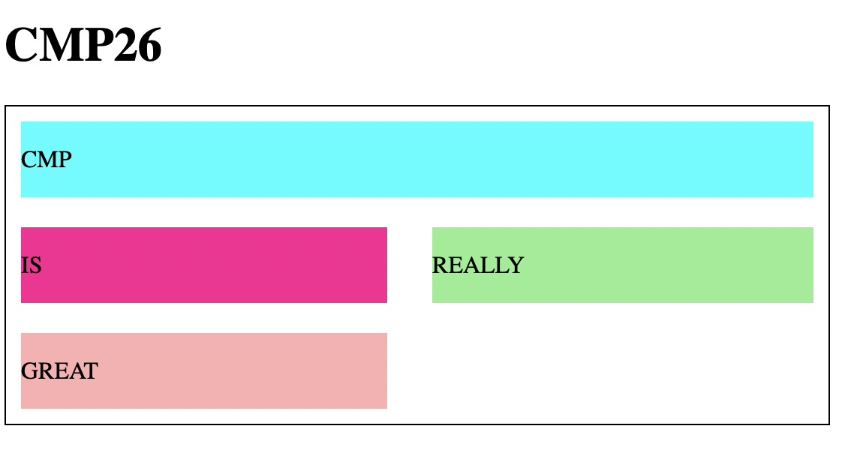
Layout: CSS Grid
grid-column
.container {
display: grid;
grid-template-columns: repeat(2, auto);
grid-template-rows: repeat(2, auto);
grid-gap: 20px 30px;
} .c1 {
grid-column: 1/3;
}
CSS
Output
There is algo grid-gap-row and grid-gap-column

Slide 63

Layout: CSS Grid
span
.container {
display: grid;
grid-template-columns: repeat(4, auto);
grid-template-rows: repeat(4, auto);
grid-gap: 20px 30px;
}
.c2 {
grid-row: span 2;
}
CSS
Output

Slide 64

Recall: CSS Layout

Slide 65
Recall: CSS Layout
Purpose: Make a layout
<div class="container" style="border: 1px solid black; padding: 10px;"">
<div class="c1" style="background-color:aqua"><p>CMP</p></div>
<div class="c2" style="background-color: DeepPink"><p>IS</p></div>
<div class="c3" style="background-color:LightGreen"><p>GREAT</p></div>
</div>
Given: Blocks with any content

Slide 66

Layout: Flex Box
display
.container {
display: flex;
}
CSS
Output
By default just stack them horizontally

Slide 67

Layout: Flex Box
flex-direction
.container {
display: flex;
flex-direction: column;
}
CSS
Output
Default is row. There is also column-reverse and row-reverse

Slide 68

Layout: Flex Box
justify-content
.container {
display: flex;
flex-direction: row;
justify-content: flex-end;
}
CSS
Output
There is also center, flex-start (default), space-between, space-around, space-evenly

Slide 69

Layout: Flex Box
justify-content
.container {
display: flex;
flex-direction: row;
justify-content: space-between;
}
CSS
Output
There is also space-around and space-evenly

Slide 70

Layout: Flex Box
justify-content
.container {
display: flex;
flex-direction: row;
justify-content: space-around;
}
CSS
Output
There is also space-evenly

Slide 71

Layout: Flex Box
wrap
.container {
display: flex;
flex-direction: row;
flex-wrap: wrap;
}
CSS
Output
There is also wrap reverse

Slide 72

Layout: Flex Box
align-items
.container {
display: flex;
flex-direction: row;
height: 100px;
align-items: center;
justify-content: center;
}
CSS
Output
Always acts in the orthogonal direction
There is flex-start, flex-end and stretch (default)

Slide 73

Layout: Flex Box
align-content
.container {
display: flex;
flex-direction: row;
height: 200px;
flex-wrap: wrap;
justify-content: center;
align-items: center;
align-content: justify-between;
}
CSS
Output
Like justify-content but always acts in the orthogonal direction
Align-items acts “per direction”

Slide 74

Layout: Flex Box
align-self
.container {
display: flex;
flex-direction: row;
height: 200px;
justify-content: space-around;
align-items: center;
}
.c2 {
align-self: flex-start;
}
CSS
Output
Let some elements violate the item alignment (start, flex-end, stretch,..)

Slide 75
Layout: Flex Box
flex-basis
.container {
display: flex;
flex-direction: row;
height: 200px;
justify-content: space-around;
align-items: center;
}
.c2 {
align-self: flex-start;
flex-basis: 30rem;}
CSS
Output
Like width or height but is along the direction
Can be exceeded with flex-grow (or decreased with flex-shrink)

Slide 76


Layout: Flex Box
flex-grow, flex-shrink
flex: 0 1 auto; is the default (shorthand for grow, shrink and auto)

Slide 77
So Far
Recapped on HTML (basics, grouping, forms, semantics)
Considered CSS (text styles, box styles and layout styles)
There are also rarely element-specific styles (e.g., list-style-type)
Let’s consider animations

Slide 78

Animations
@keyframes example {
0% {background-color: red;}
25% {background-color: yellow;}
50% {background-color: blue;}
100% {background-color: green;}
}
div {
width: 100px;
height: 100px;
background-color: red;
animation-name: example;
animation-duration: 4s;
}
@keyframes
animation-name
animation-duration
animation-delay
animation-iteration-count
animation-direction
animation-timing-function
animation-fill-mode
animation

Slide 79

Media Query
@media only screen and (max-width: 600px) {
body {
background-color: lightblue;}
}

Slide 80
Alternatives to CSS
SCSS
.button {
background-color: $primary-color;
color: white;
border-radius: $border-radius;
padding: 10px 20px;
border: none;
cursor: pointer;
.button {...}
}
Tailwind
<button class="bg-blue-500 text-white rounded px-4 py-2">Click Me</button>
Bootstrap
<button class="btn btn-primary">Click Me</button>

Slide 81


Searching is Important
JavaScript is Next!

Slide 82
Thank You

